Slide 1
50.003: Elements of Software Construction
Week 1
Introduction to Software Design

Slide 3
Plan for the Week
This class: Software Design Basics and Use Case
Next Week:
UML: Class Diagrams
UML: State Machine Diagrams

Slide 5
What is Design?
choice 1
Design Space
choice 2
choice 3
choice 4
(e.g. Hardware)
choice 5
choice 6
choice 7
choice 8
choice 9
Good Designs
ch. A
ch. B
ch. C
ch. D
ch. E
ch. F
ch. G
(e.g. Algorithm)

Slide 6
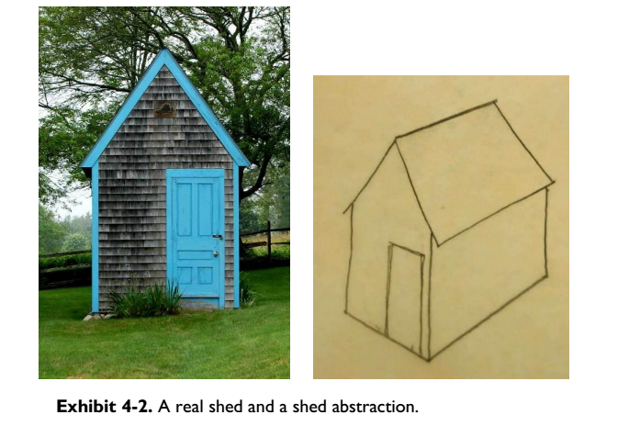

Slide 7
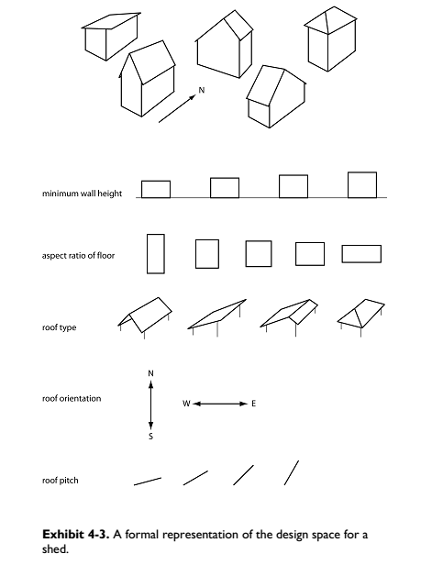

Slide 8
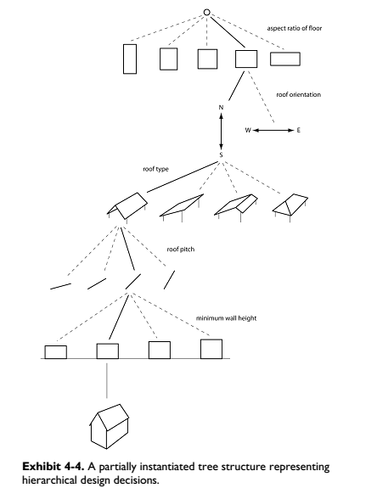

Slide 9
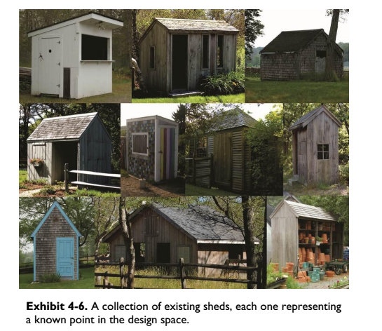

Slide 10
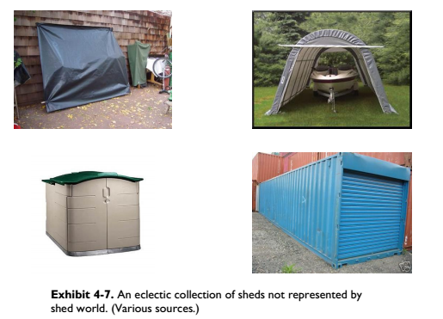

Slide 11
The Rational Model
Input: Goal, Desiderata, Utility function, Constraints, Design tree of decisions
Until (“good enough”) or (time runs out) {
Do another design (to improve utility function)
Until design is complete
Backtrack up design tree
Explore a path not searched before While design remains feasible,
make another design decision
EndWhile
EndUntil
EndDo
Take best design
EndUntil

Slide 12

The Rational Model
Backtrack
Design Decision
✅
Design is good
Design is infeasible

Slide 13
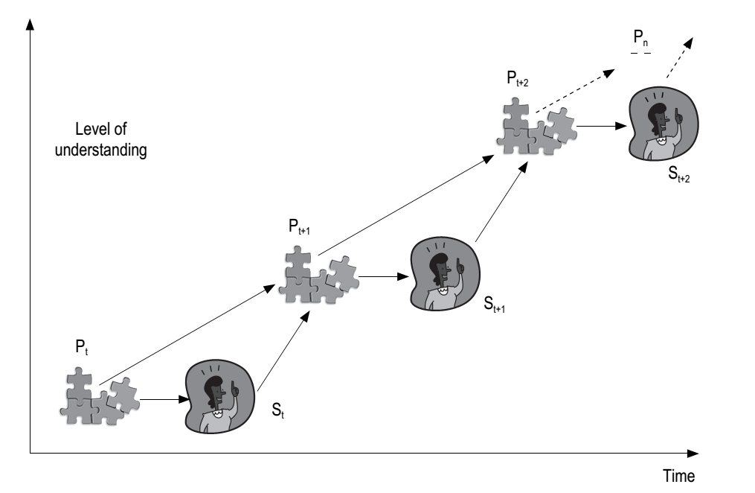
Criticizing the Rational Model
Software Engineering: Concepts and Applications by Subhajit Datta
(Oxford University Press, 2010)

Slide 14
Software Design is Hard (cont’d)
Even if we know all the design choices, the combinations of design choices are exponential and therefore it may not be easy to find a good design.

Slide 15
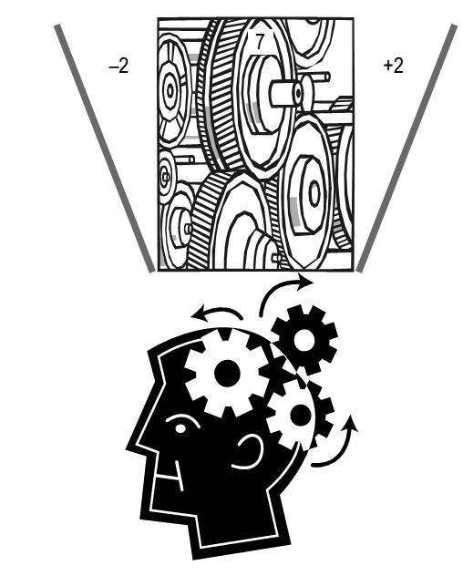
ADDRESSING COMPLEXITY IN DESIGN
Miller’s Law
At any time a human being can concentrate on 7 +- 2 chunks (quota of information)
Notes:
What’s the implication in software engineering? We concentrate on the most relevant details at a point and ignore the details. Refine design strategies step by step.

Slide 16
Strategies for addressing complexity
Decomposition
Abstraction
Hierarchy

Slide 17
Decomposition
Divide et impera (divide and rule) is a technique of mastering complexity in vogue since ancient times [Dijkstra 1979].
Key idea:
Break down a system into smaller and more manageable parts, so that the channel capacity of our comprehension is not breached.
Coupling and Cohesion
Notes:
Human mind can handle complexity only up to a certain threshold. Hence, decomposition helps in the design process. For your app searching for restaurants, let us say someone focus on the search algorithm whereas someone focus on the GUI development.

Slide 18
Decomposition
Big System
Subsystem A
Subsystem C
Coupling
Cohesion
Subsystem B
Notes:
Human mind can handle complexity only up to a certain threshold. Hence, decomposition helps in the design process. For your app searching for restaurants, let us say someone focus on the search algorithm whereas someone focus on the GUI development.

Slide 19
Decomposition
Big System
Subsystem A
Subsystem C
Coupling
Cohesion
Subsystem B
Is it a Good Design?
Notes:
Human mind can handle complexity only up to a certain threshold. Hence, decomposition helps in the design process. For your app searching for restaurants, let us say someone focus on the search algorithm whereas someone focus on the GUI development.

Slide 20
Decomposition
Big System
Subsystem A
Subsystem C
Coupling
Cohesion
Subsystem B
Is it a Good Design?
Notes:
Human mind can handle complexity only up to a certain threshold. Hence, decomposition helps in the design process. For your app searching for restaurants, let us say someone focus on the search algorithm whereas someone focus on the GUI development.

Slide 21
Cohort Exercise 1.1
Assume you are designing a dating application which displays relevant matches via a configurable distance parameter. This means the user can configure the distance/location parameter, say 20 Km/Singapore, the app will find relevant matches within this distance and display it. The user can like or dislike the matches, based on which the app will compute what type of matches to show the user in the future. Decompose the application into (at least) four subsystems. Label the Coupling and Cohesion edges to show interaction.

Slide 22

Abstraction
The power of abstraction
Abstraction is at the center of much work in Computer Science.
It encompasses finding the right interface for a system as well as
finding an effective design for a system implementation.

Slide 23
Abstraction
One of the most frequently used words in the context of software design
Key idea:
Unable to master the entirety of a complex object, we choose to ignore its inessential details, dealing instead with the generalized, idealized model of the object [Booch et al. 2007].

Slide 24

Abstraction
CPU
Cache
RAM
DISK 1

Slide 25
Abstraction
CPU
Cache
RAM
DISK 1
FF
Watch Movie “Spiderman” from disk address 0xFF

Slide 26
Abstraction
DISK 2
FF
Watch Movie “Iron Man” from disk address DISK2:0xFF
CPU
Cache
RAM
DISK 1
FF
Watch Movie “Spiderman” from disk address DISK1:0xFF

Slide 27
Abstraction
DISK 2
Open file (“Iron man”)
Open file (“Spiderman”)
FF
File System
Operating
System
DISK 1
FF
File system is an abstraction we use in daily life. All details
on where are how data and retrieved are hidden.
The “open file” call abstracts all details away.

Slide 28
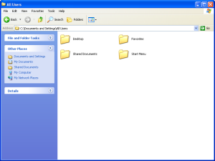
Abstraction
Level of Abstraction
GUI
import java.io.*
Libraries, Packages, …
open();
close();
seek();
System Calls
Which level of abstraction
do you work on?
Write_to_Disk_Block();
Disk /Hardware /Driver

Slide 29
Abstraction
Level of Abstraction
GUI
import java.io.*
Libraries, Packages, …
open();
close();
seek();
System Calls
What is a good abstraction?
Write_to_Disk_Block();
Disk /Hardware /Driver

Slide 30
Abstraction
Level of Abstraction
GUI
Includes everything down
import java.io.*
Libraries, Packages, …
open();
close();
seek();
System Calls
What is a good abstraction?
Write_to_Disk_Block();
Disk /Hardware /Driver

Slide 31
Abstraction
High-level programming language is another abstraction we use daily
It abstracts away the low-level implementation details
Which processor?
What type of Memory?
What type of system (PC, supercomputer, embedded systems)?

Slide 32
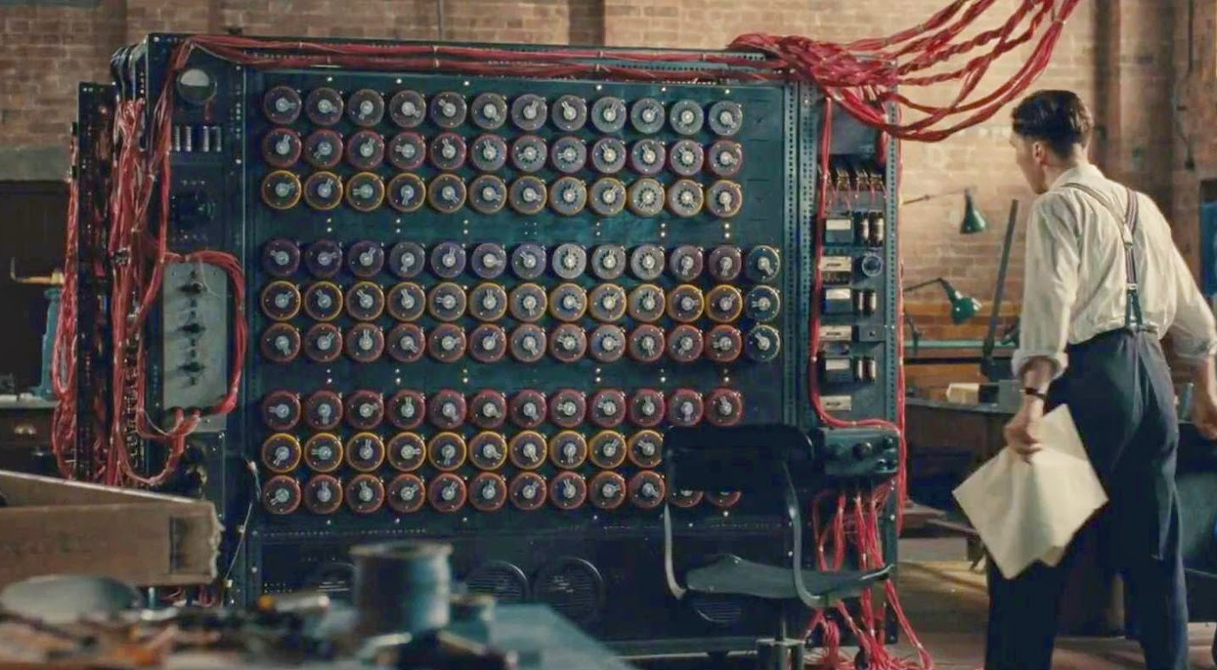
What’s that?

Slide 33
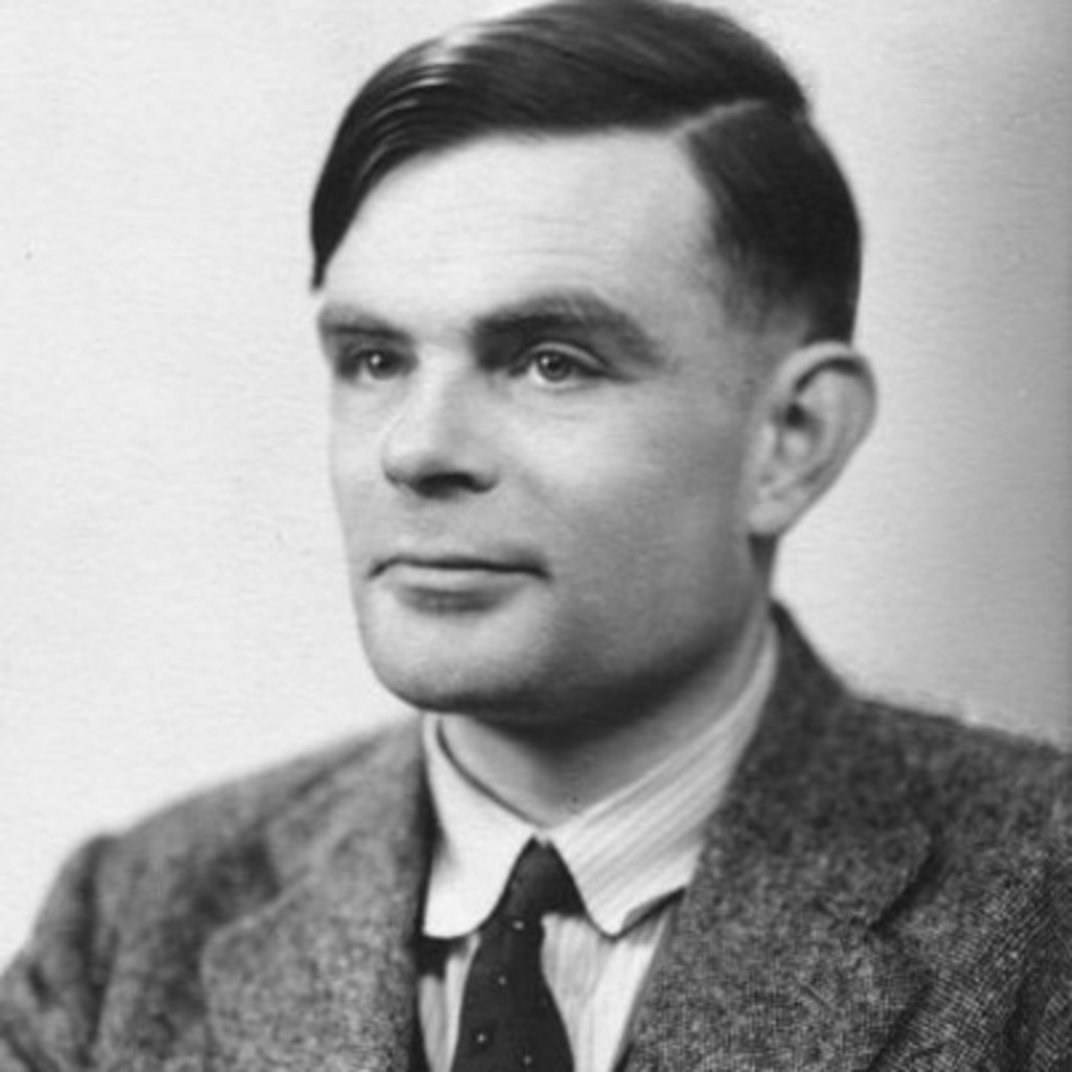
Abstraction
A Language is turing complete if it can be
used to simulate any turing machine.

Slide 34
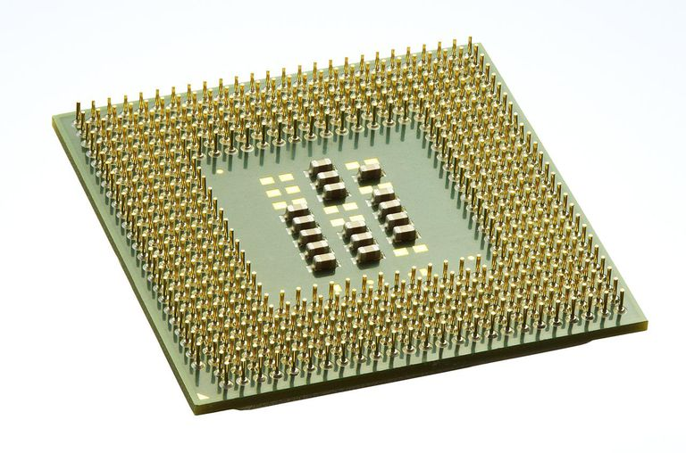
Abstraction
Level of Abstraction
DSL (domain specific)
Includes everything down
import java.io.*
JAVA
mov x, r2
add r1, r2
mov r1, y
Assembly code
Programming languages
ISA (Turing complete)

Slide 35
Abstraction
Level of Abstraction
DSL (domain specific)
Not Turing Complete
Lambda
Calculus
Simply typed lambda
calculus
mov x, r2
add r1, r2
mov r1, y
Assembly code
Programming languages
ISA (Turing complete)

Slide 36
Cohort Exercise 1.2
A railway network (see next slide) consists of several tracks, junction points and trains. A train moves along the track until it requires to change the track to reach destination. The changes of track occur only through a junction point. Each train is initially positioned at a junction point and its destination is a different junction point. Hence, while a train approaches its destination junction point, it does not need to change tracks any more. Each track can have at most one train at a time to avoid collision, but all tracks in the railway network are bi-directional. Design a set of APIs (application programming interface) for a safe (i.e. collision free) system. No coding is required, the APIs and their purpose will suffice.

Slide 37
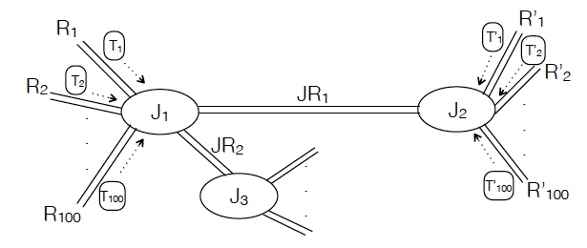
Cohort Exercise 1.2
Trains
Junction Point
Tracks

Slide 38
Hierarchy
Whenever we examine something new or something that seems to be complex, we try to see what common characteristic it shares with other things we know, or if it is part of something we have seen earlier.
Key idea:
“Is a” relation: E.g. a car is a locomotion device with wheels
“Part of” relation: A part of a car is the engine
Notes:
You know Java and Object oriented programming. Hence, you know about inheritance. Give examples of the Employee class who have similar benefits but distinguish special features of assistant, associate and full professors and administration.

Slide 39
Cohort Exercise 1.3
Consider the railway network from previous exercise. Assume tracks of different type – broad gauge, meter gauge and narrow gauge. Each junction point is further divided into individual establishments that exclusively handle a specific track (i.e. meter, broad or narrow). Similarly, trains for meter gauge track is different from trains for broad gauge and narrow gauge. Narrow gauge trains are not powerful to run longer than the distance between two junction points. At each junction point, therefore, its engine is changed. Refine your set of APIs to capture this system.

Slide 40
Cohort Exercise 1.4
Design and implement a program that supports accepting two complex numbers from the user; adding, subtracting, multiplying, and/dividing them; and reporting each result to the user.

Slide 41
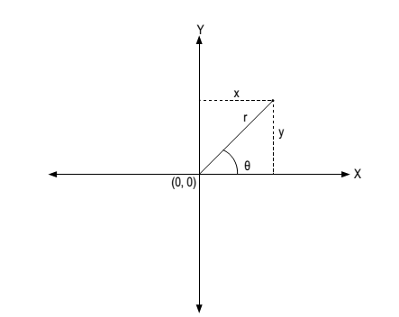
Cohort Exercise 1.4 (cont’d)
Support complex numbers in both rectangular form and polar form.

Slide 42

Further Reading
Parnas, David L., (December 1972). “On the Criteria to be Used in Decomposing Systems into Modules". Communications of the ACM. Volume 15, Number 12, pages 1053-1058
http://tinyurl.com/2cf9lx6

Slide 43
The Languages of software development

Slide 44
The Spectrum of Languages
Languages for implementation:
programming languages: precise and executable but perhaps not a good media for communication
Languages for software development process:
modelling languages: often visual, often not executable, high-level, aiming for communication between different parties in software development processes
Languages for user requirements:
Structured English: not visual, not executable, not precise, extremely flexible

Slide 45
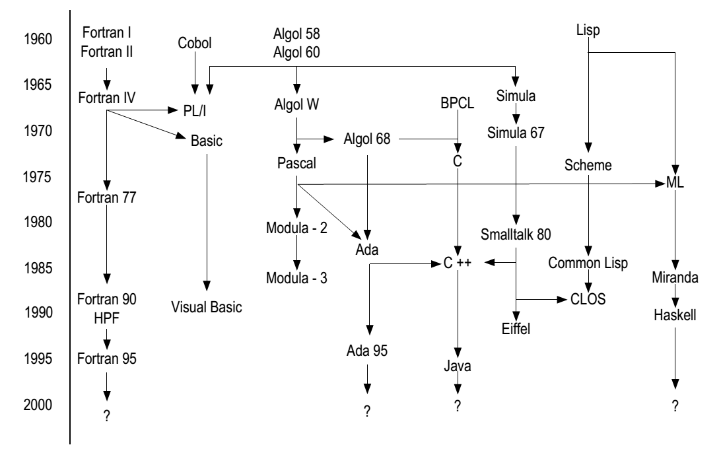
Lineage of programming languages
Check this out: http://www.levenez.com/lang/lang_a4.pdf
Notes:
Talk about C, C++, Java. Talk about Basic, it used to be the language I started. Ask question whether anybody knows Basic? Talk about Cobol – language used in mainframe system. Talk about LISP, functional language.

Slide 46
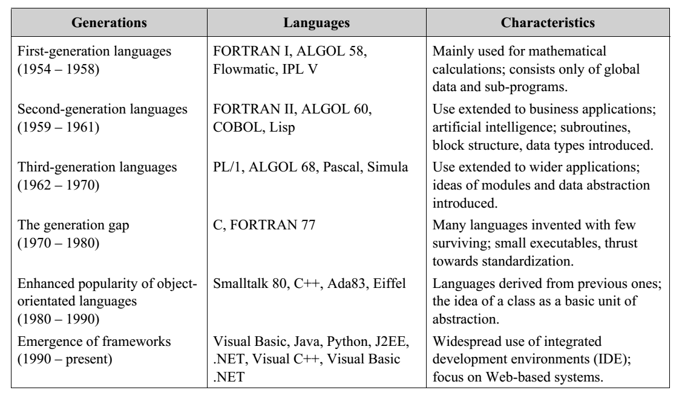
Generations of PL

Slide 47
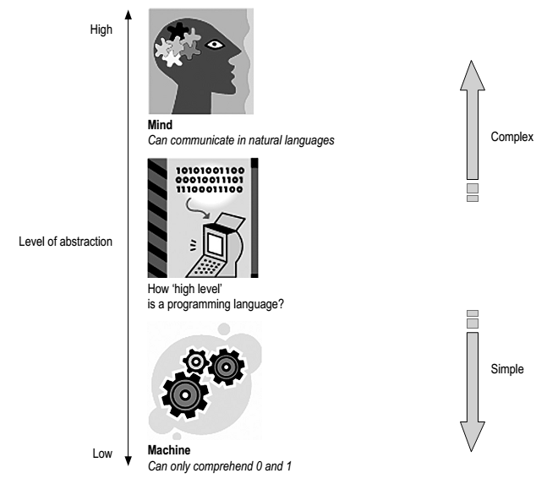
The High and Low of PL
Software Engineering: Concepts and Applications by Subhajit Datta
(Oxford University Press, 2010)
Notes:
Well of course, we cannot just use natural language. Again we cannot also use 0 or 1 to write program (I used to). Finding the right level of abstraction for programming application is important.

Slide 48
Why Modeling Languages?
Modeling languages are mainly for documentation and communication.
Documentation is an important part of software engineering.
Documentation is perhaps a part of any software development process.
It forms the basis of an iterative design process.
It forms the basis of effective communication among three parties, through time.
There are formal modeling languages and informal ones.

Slide 49
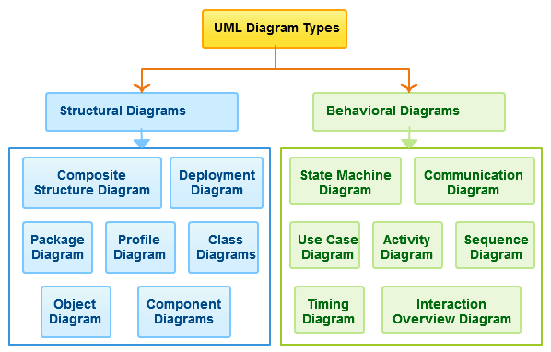
Unified Modelling Language
UML is extensible.
There are 14 UML diagram types.
UML is flexible.

Slide 50
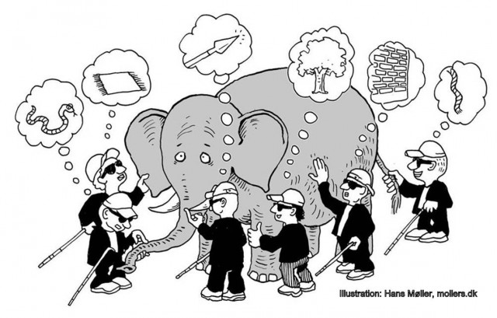
Why so many diagrams?
http://mappingignorance.org/2013/07/25/selective-ignorance-in-science/

Slide 51
We Will Cover
Use Case Diagrams
Sequence Diagrams
Class Diagrams
State Diagrams

Slide 52
User Requirements: a Case Study
Preeti is leading a team of software engineers engaged in building the system. Kuber Bank (KB) has been in the banking business for over thirty years with branches all over India. About 15 years ago, the branches were computerized and they are currently connected through a nation-wide network. To keep up with the competition, KB needs to offer online banking facilities to its customers. Preeti’s organization has won the contract to ‘Webify’ KB. An initial meeting was arranged between KB’s senior management and Preeti’s team to understand the scope of the projects.
- ‘So, as a first step, it would be good for us to know the broad requirements you have in mind’, began Preeti.
- ‘Well, we want to let the customers do online all they can do at a branch’, Sanjeev Kumar, KB’s senior vice-president, replied.
Software Engineering: Concepts and Applications by Subhajit Datta
(Oxford University Press, 2010)
Notes:
What do you get from this requirement? Extremely informal to start with.

Slide 53
Roles and Functionality
User can:
View their profile information
View list of their accounts with the bank
View transactions for each of their accounts
Send messages to the bank
View history of messages they have sent to the bank and replies from the bank
Administrator can:
View transactions across all accounts
Add transactions to any account
Delete transactions from any account
Review all messages sent by users
Reply to messages sent by users

Slide 54
Glossary
Account: the bank account held by a user with Kuber Bank (KB), identified by a unique account number
Administrator: A special type of user who has unique privileges in manipulating information relevant to KBO.
KBO: the Kuber Bank Online system
User: An account holder of KB who is allowed by KB to use KBO
…
Can the Administrator be an User too?
Notes:
Say if the administrator is user, she can transfer money or view all money associated with different accounts.

Slide 55
Description of Requirements
KBO_Req_01: Recording Transaction Details in KBO by administrator
Administrator shall access transaction information of a particular account on a periodic basis and record the same in the KBO system such that user can view them through the Web interface. The transaction information will be available to be accessed by the administrator in the existing Master Ledger (ML) system. Details for a transaction need to be available at KBO for viewing by a user within 48 hours after the transaction have been initiated by the user.
Is this good enough?

Slide 56
Cohort Exercise (5 minute)
Read the requirement and find out some incompleteness or ambiguity.
Administrator shall access transaction information of a particular account on a periodic basis and record the same in the KBO system such that user can view them through the Web interface. The transaction information will be available to be accessed by the administrator in the existing Master Ledger (ML) system. Details for a transaction need to be available at KBO for viewing by a user within 48 hours after the transaction have been initiated by the user.

Slide 57
Description of Requirements
KBO_Req_01 Expanded
Administrator shall manually access transaction information for a particular account on a periodic basis from the existing Master Ledger system. (Automation of this access mechanism is outside the scope of KBO’s current release and may become a Requirement for a future release.) Administrator shall record the transaction information for a particular account accessed from the ML system, in the KBO system. Only successful transactions need to be available at KBO for viewing by users within 48 hours after they have been initiated by the user. Users will be notified of failed transactions through procedures outside the scope of KBO’s current release.

Slide 58
Description of Requirements
KBO_Req_01: Non-functional Parts
Ensuring transactions are recorded in a format that makes it reasonably easy to be understood by users. (user friendly)
Ensuring successful transactions are recorded at KBO within 48 hours of their initiation. (performance)
Ensuring large volumes of transaction for a particular account within a particular period of time can be handled. (scalability)
Notes:
Not affect the core functionality , but very important for the business.

Slide 59
Use Case
“To my knowledge, no other software engineering language construct as significant as use cases has been adopted so quickly and so widely among practitioners. I believe this is because use cases play a role in so many different aspects of software engineering.”
Ivar Jacobson
Founding father of UML
Creator of Use Case Diagram

Slide 60
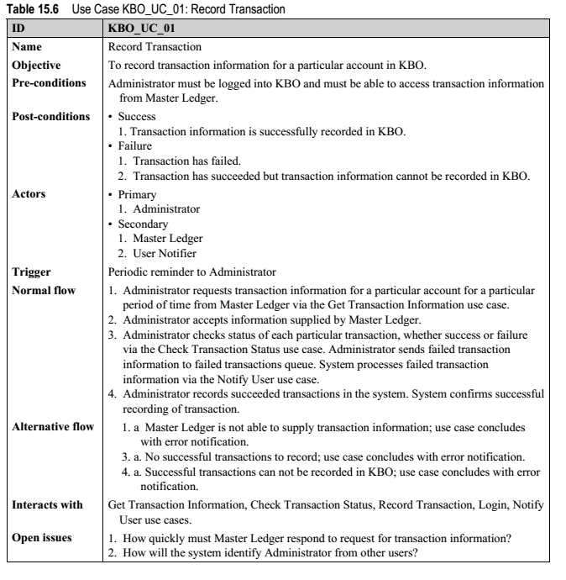
Software Engineering: Concepts and Applications by Subhajit Datta
(Oxford University Press, 2010)
Notes:
“Interacts with” captures the set of use case documents “this” use case interacts with.

Slide 61
Use Case
Constraints - The formal rules and limitations a Use Case operates under, defining what can and cannot be done. These include:
Pre-conditions that must have already occurred or be in place before the use case is run; for example, <create order> must precede <modify order>
Post-conditions that must be true once the Use Case is complete; for example, <order is modified and consistent>
Invariants that must always be true throughout the time the Use Case operates; for example, an order must always have a customer number.

Slide 62
Flow of Events
Basic flow of events
Is the most common pathway. It usually depicts a perfect situation, in which nothing goes wrong.
Alternative flow of events
Is a pathway that is still considered a good pathway; it’s just not the most heavily travelled one.
Exception Flow of Events
Things don’t always go as planned. An exception is an error condition that is important enough to the application to capture.

Slide 63
Cohort Exercise 3
Work as a group, document one use case of the App that you are developing.

